Slide 1
ClimbCode

Slide 2

Our Path Today
The Workgroup
Idea & MVP
Business and costs
Work Methodology
2

Slide 3
The Workgroup

Slide 4
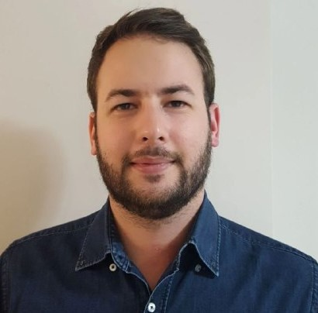

The Workgroup
Alejandro Román Rodríguez
Project Manager
Álvaro Domínguez Núñez Business Manager
4

Slide 5
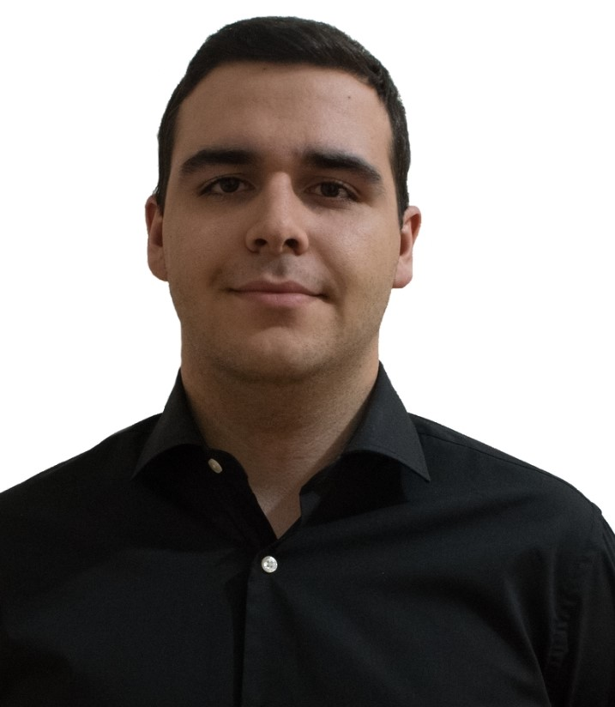
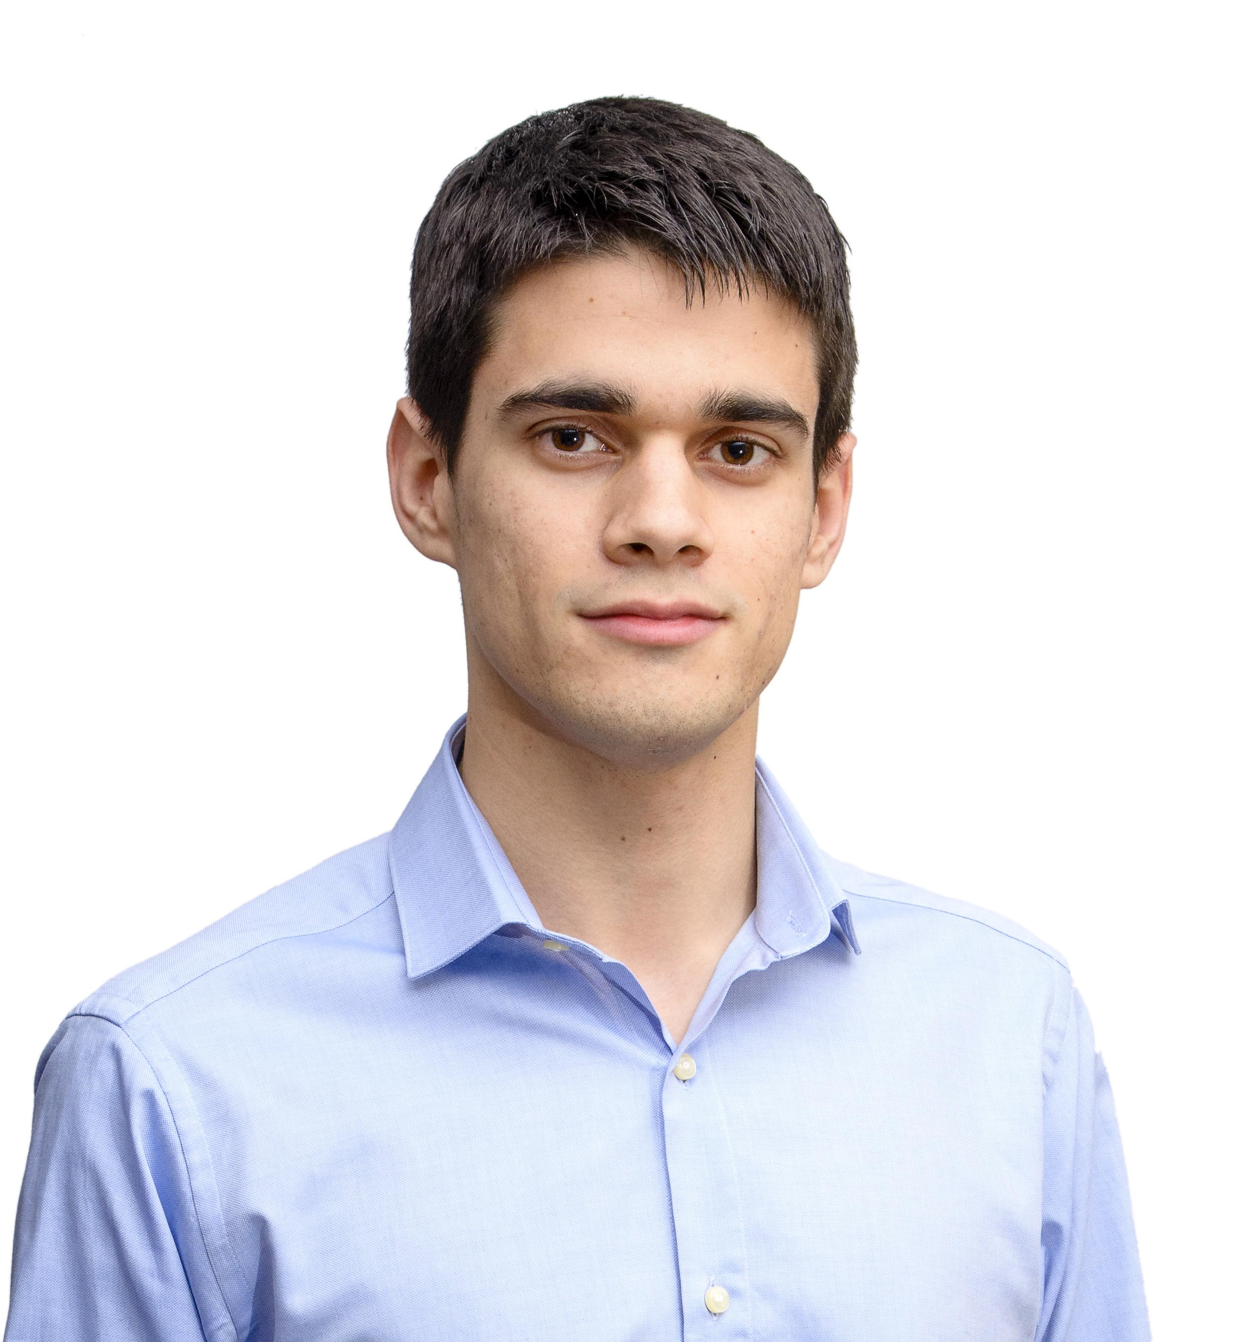
The Workgroup
Andrés Fernández Alés
Software Engineer
Alejandro Garrido Resina
Software Engineer
4

Slide 6
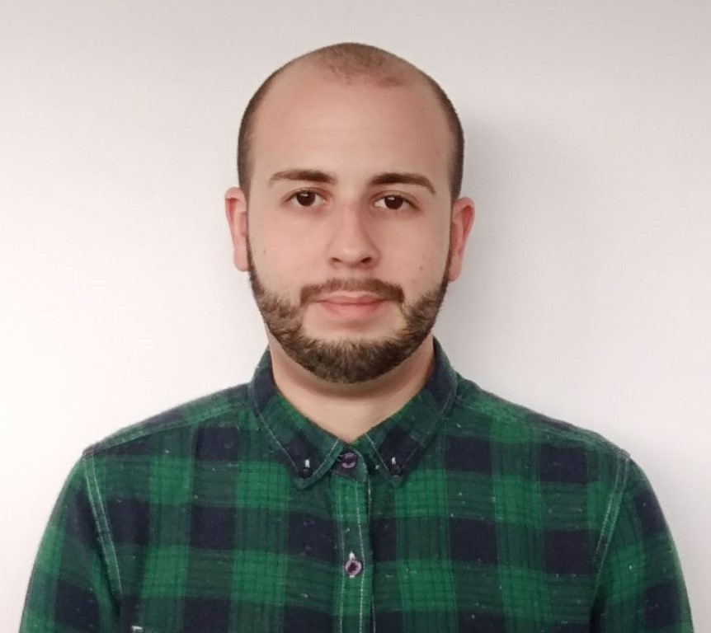
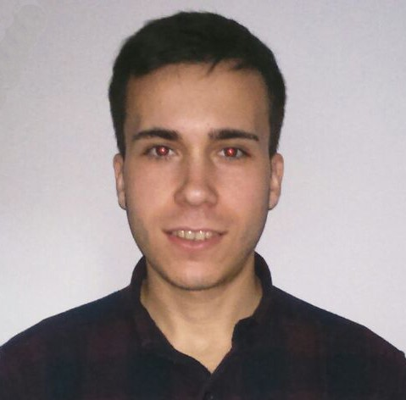
The Workgroup
Miguel Ángel Baños Carretón Software Engineer
Álvaro Sánchez López
Software Engineer
4

Slide 7
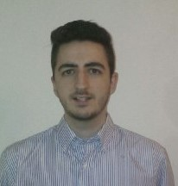
The Workgroup
Jesús Sosa Sánchez
Software Engineer
4

Slide 8
Idea & MVP

Slide 9


Idea & MVP
+
=
ClimbCode
9

Slide 10


Idea & MVP
=
+
Interactivo
10

Slide 11

Learn Programming?
11

Slide 12

Learn Programming?
11

Slide 13

Idea & MVP
Interactivo
13

Slide 14

Idea & MVP
Interactivo
13

Slide 15

Idea & MVP
Interactivo
14

Slide 16

Idea & MVP
Student & Teacher:
Interactivo
15

Slide 17

Idea & MVP
Administrator:
17

Slide 18
Let’s have a look
18

Slide 19
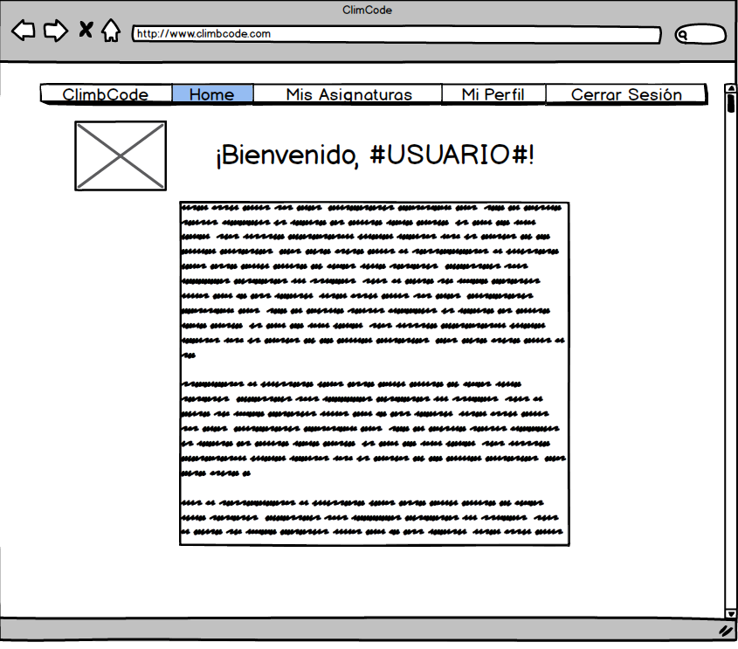
19

Slide 20
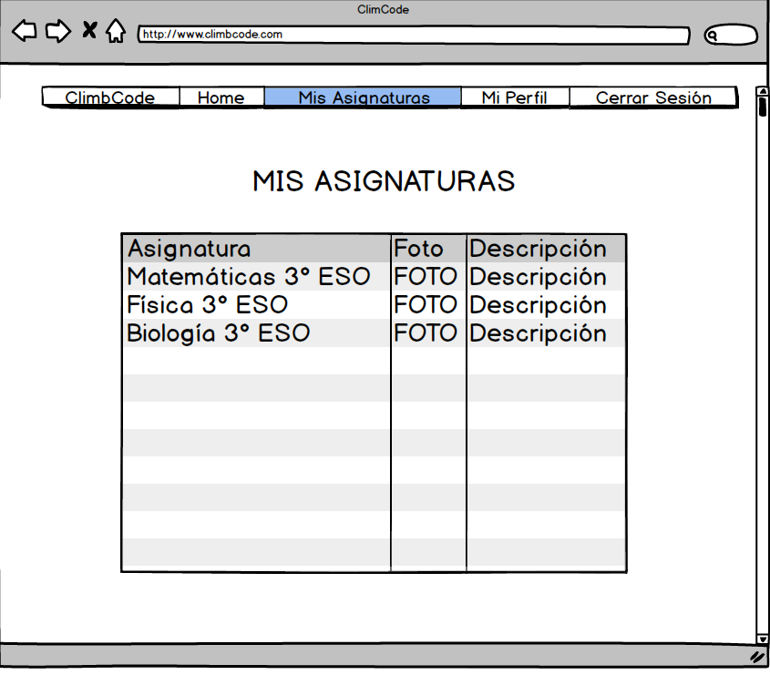
20

Slide 21
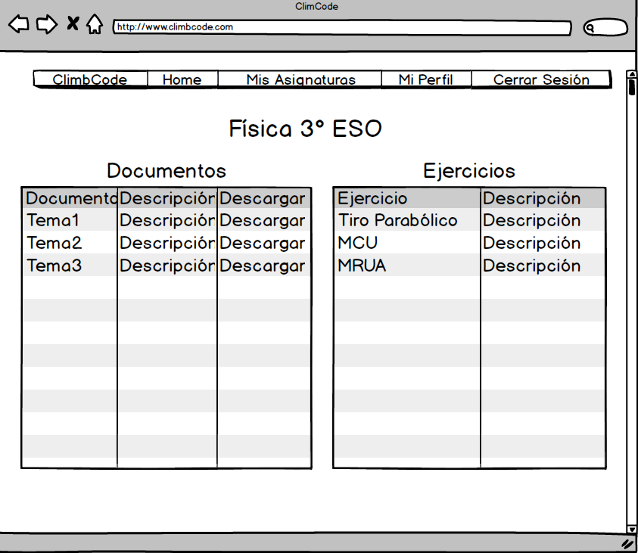
21

Slide 22
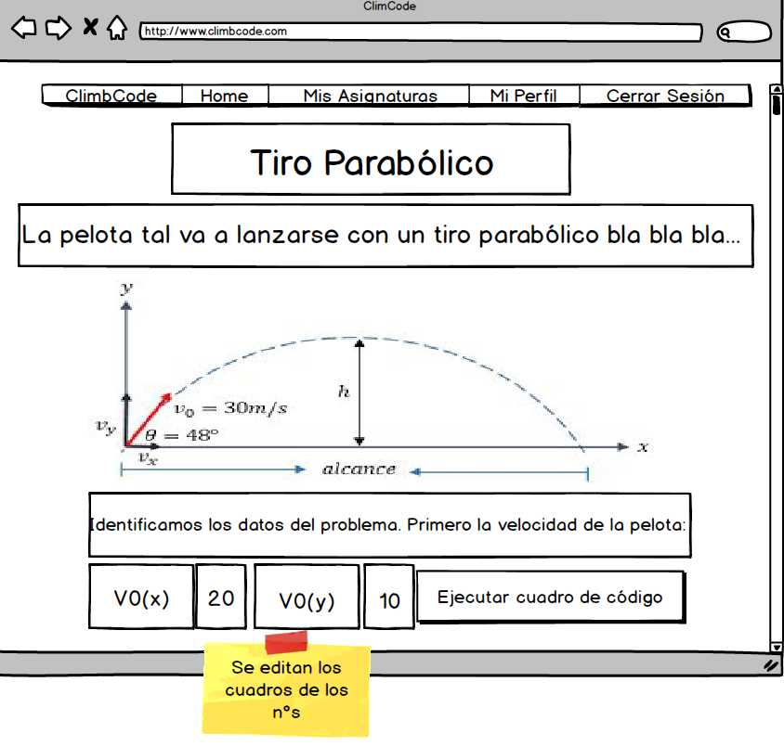
22

Slide 23
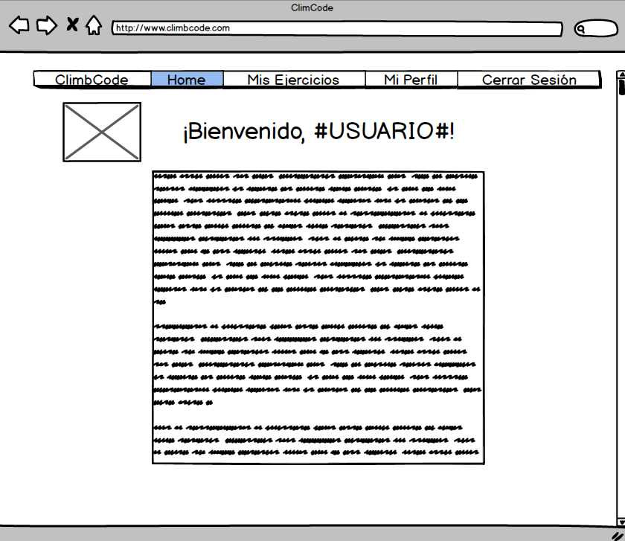
23

Slide 24
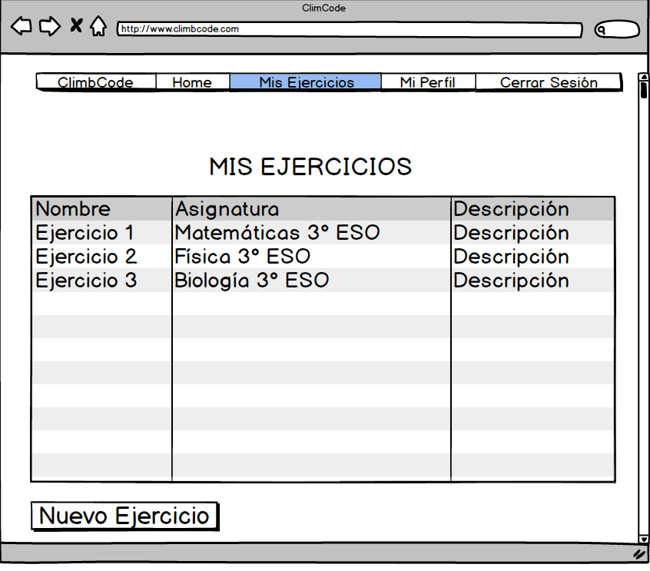
24

Slide 25
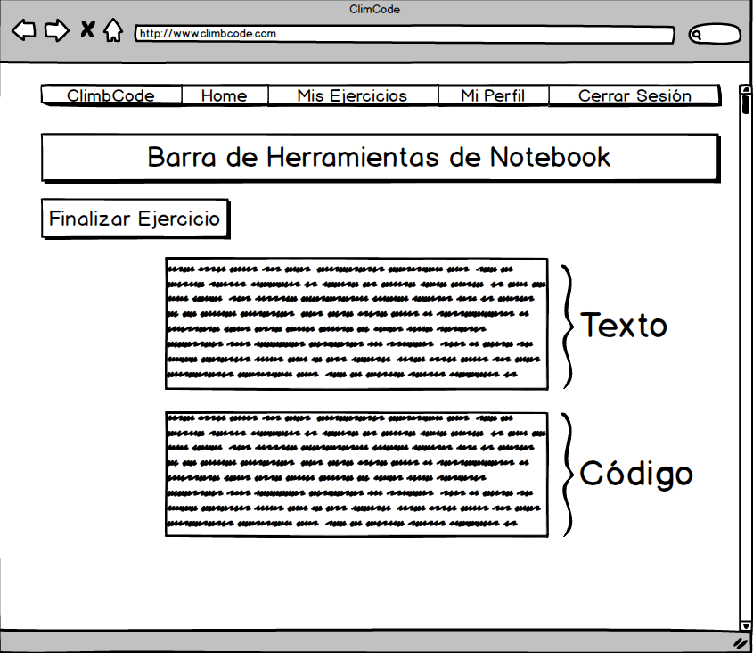
25

Slide 26





Idea & MVP
26

Slide 27





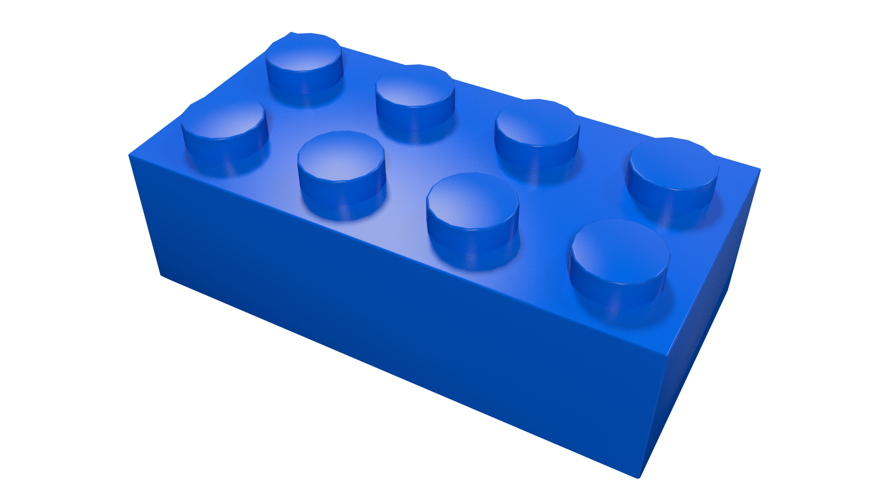
Idea & MVP
27

Slide 28
Business and Costs

Slide 29
Is it worth it?
30

Slide 30
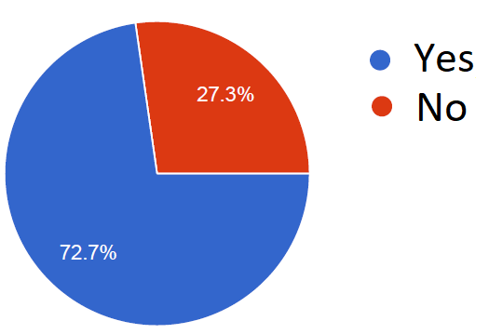
Business and Costs
From 88 people: Related to teaching
31

Slide 31
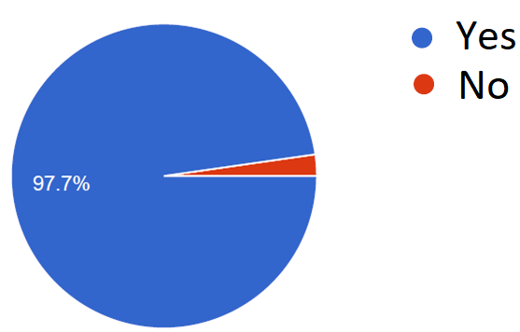
Business and Costs
From 88 people: Thoughts about programming
32

Slide 32
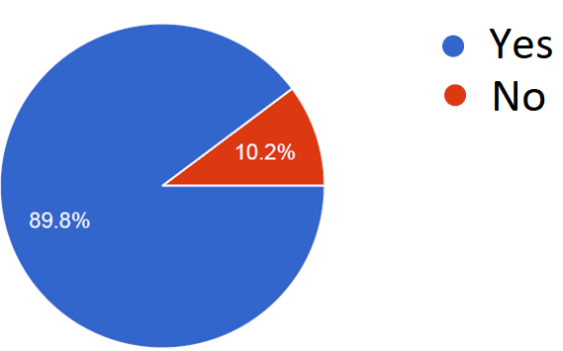
Business and Costs
From 88 people: Want a tool for programming at school
33

Slide 33
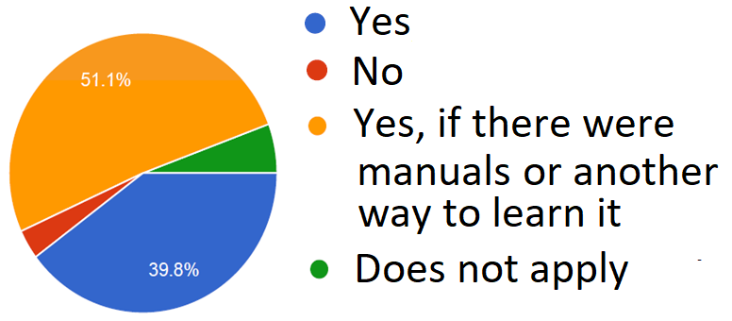
Business and Costs
From 88 people: Would use the tool
34

Slide 34
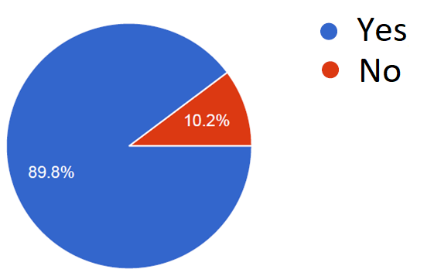
Business and Costs
From 88 people: Thoughts about students
35

Slide 35

How much?
36

Slide 36
Business and Costs
Direct Costs: 3700 €/m
Indirect Costs: 4750 €/m
Amortizations: 800 €/m
37

Slide 37
Business and Costs
9250 €/m
37000 € + 4000 € = 41000 €
38

Slide 38
Business and Costs
39

Slide 39
Business and Costs
39

Slide 40
40

Slide 41


Business and Costs
41

Slide 42
Business and Costs
%
Interactivo
42

Slide 43
Work Methodology

Slide 44

Work Methodology
SCRUM: Three Sprints.
44

Slide 45

Work Methodology
Sprint 1:
Interactivo
45

Slide 46
Work Methodology
Future Sprints:
Interactivo
46

Slide 47



Work Methodology
Development:
47

Slide 48

Work Methodology
Knowledge:
48

Slide 49

THANKS!
You can find me at
alvdomnun@alum.us.es
49

